Slide 1
Computer Graphics Modeling
László Szécsi szecsi@iit.bme.hu
AIT

Slide 2
JSON model file format
designed for WebGL
easy to load from JS
contains data in ready-to-use-in-buffers format
download from Moodle
or convert your own using Blender
see the Blender slides and video
use the script on Moodle

Slide 3
Geometry loaded from file
create new SubmeshGeometry.js similar to TexturedQuadGeometry.js
constructor takes an object, describing a mesh as loaded from JSON file, having the properties:
property vertices: 3n coordinates in continuous array
property normals: 3n elements in continuous array
property texturecoords: array (typically with a single element, as the model has only one set of texture coordinates) of continuous arrays of 2n elements
property faces: array of n arrays of 3 indices
make continuous array using
const indices = [].concat.apply([], jsonObject.faces);
texturecoords[0]
the expressions in red replace array literals
but wrapping them in typed arrays must remain

Slide 4
Geometry loaded from file
replace quad geometry data with data arrays from JSON
you still need to make them into typed arrays!
passing regular JS arrays instead of typed arrays does not immediately fail, but drawing will not work
it is not 6 indices we have to use when drawing
in the constructor, store number of indices as a property in SubmeshGeometry
use it when drawing
this.indexCount = indices.length;

Slide 5
MultiMesh concept
a UniformProvider component
a collection of meshes (called submeshes)
MultiMesh#draw is UniformProvider#draw
which just calls draw for all submeshes
it has a draw method, therefore it can substitute for a mesh in GameObject
“if it quacks like a duck, it’s a duck”
constructible from a json model file
must initiate loading file
handle mesh creation when file loaded
using the SubmeshGeometry constructor

Slide 6
MultiMesh.js – load file
class MultiMesh extends UniformProvider {
constructor(gl, jsonModelFileUrl, materials) {
super("multiMesh");
const request = new XMLHttpRequest();
request.overrideMimeType("application/json");
request.open("GET", jsonModelFileUrl);
request.onreadystatechange = () => {
// next slide
};
request.send();
this.addComponentsAndGatherUniforms(...materials);
}
an array of materials, one for each submesh
avoids "not-well-formed XML" warning in Firefox
Actual submeshes will be loaded later. In the meantime, we add materials as children so that properties can be added to game objects using this multimesh.

Slide 7
MultiMesh.js – create meshes
if (request.readyState == 4) {
const submeshes = [];
const meshesJson = JSON.parse(request.responseText).meshes;
for (let i = 0; i < meshesJson.length; i++) {
submeshes.push( new Mesh(
materials[i],
new SubmeshGeometry(gl, meshesJson[i]),
));
}
this.components.clear();
this.addComponentsAndGatherUniforms(...submeshes);
};
get rid of materials
add actual components

Slide 8
Use MultiMesh to display 3D object
create materials for both submeshes
same program, different texture
create MultiMesh, pass array of materials
create game object using the multi mesh

Slide 9
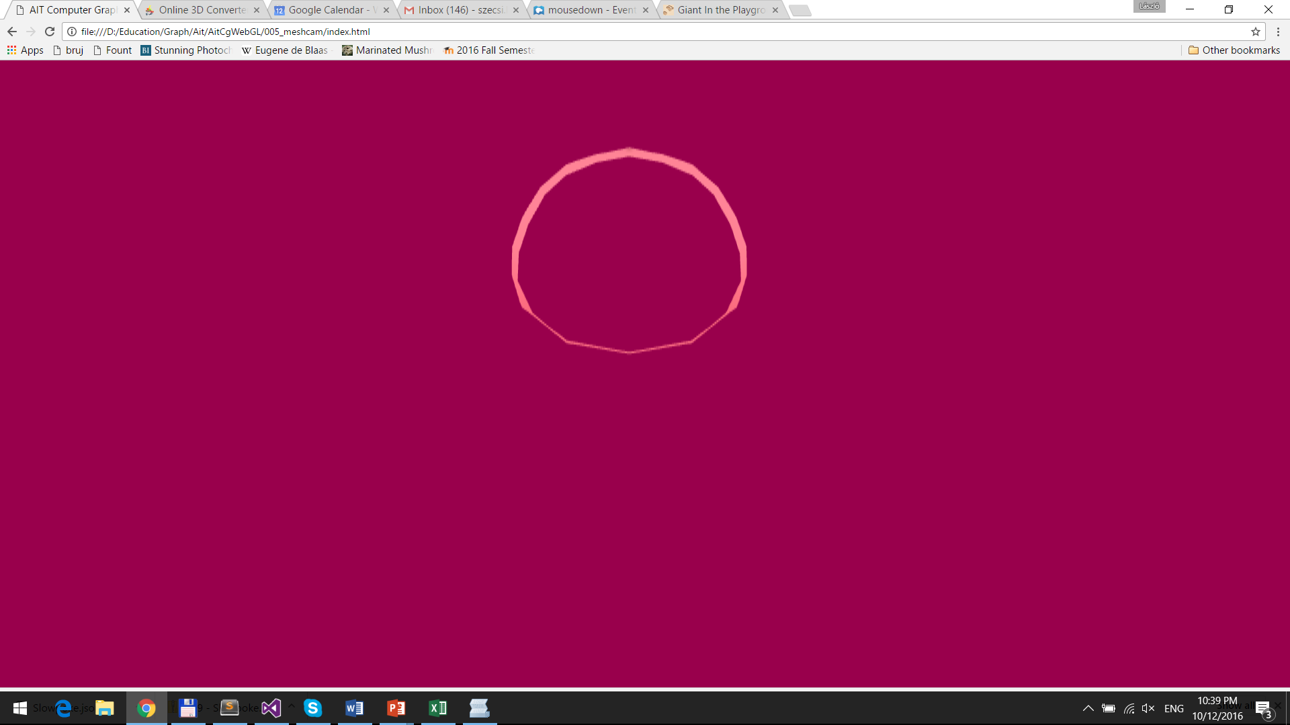
Part of object that coincides with visible area shown (your camera may be different)

Slide 10
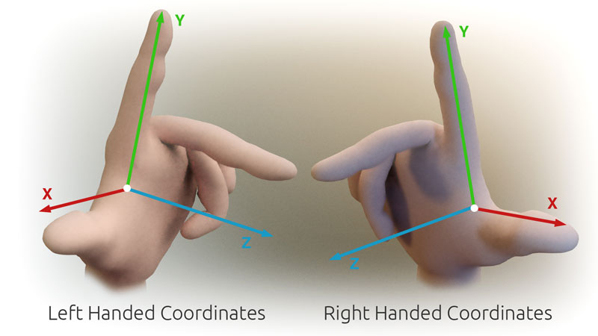
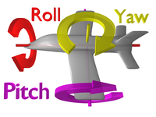

Yaw-pitch-roll: a way to specify 3D orientation
right-handed coordinates
main directions
x: right
y: up
z: back (ahead is -z)
rotation angles:
yaw – around y
pitch – around x
roll – around z
y
x
z

Slide 11
3D rotation in GameObject
this.modelMatrix.set().
scale(this.scale).
rotate(this.roll).
rotate(this.pitch, 1, 0, 0).
rotate(this.yaw, 0, 1, 0).
translate(this.position);
properties roll, pitch, yaw replace orientation
in GameObject#update

Slide 12
Make object fully visible
set game object scale (approx. 0.1, 0.1, 0.1)
rotate (e.g. half π around the vertical axis)
enable depth testing to avoid further away parts showing through
gl.enable(gl.DEPTH_TEST);
avoid transparency
either disable alpha blending
or make sure your fragment shaders sets unit alpha

